Slide 1


UNIVERSITY COLLEGE OF ENGINEERING & TECHNOLOGY VINOBA BHAVE UNIVERSITY
BITCOIN PRICE PREDICTION

Slide 2
UNIVERSITY COLLEGE OF ENGINEERING & TECHNOLOGY VINOBA BHAVE UNIVERSITY
Topic : BITCOIN PRICE PREDICTION
PRESENTED BY : ANISHA KUMARI (1911102)
RAHUL KUMAR (1911113) SAURABH KR. DEEPAK (1911116)
SHIVAM ANAND (1911117)
JAULY KUMARI (1911127)
Project Guide
Mr VIKASH KISHORE
(Asst. Professor)
Supervised by:
Mr. Sumeet Sinha
Head Of Department
(IT)

Slide 3

CONTENTS:
Bitcoin Price Concepts
Machine Learning
LSTM Model
ARIMA Model

Slide 4

Bitcoin Price Concepts :
Bitcoin price concepts revolve around volatility, speculation, and supply-demand dynamics. It is a decentralized digital currency whose value fluctuates based on market forces. Factors like investor sentiment, regulatory decisions, and technological advancements influence its price. Bitcoin's limited supply, scarcity, and growing adoption contribute to its perceived store of value, attracting both enthusiasts and skeptics.

Slide 5


Biggest Confusion of the era:

Slide 6
Machine Learning Techinques:

Slide 7
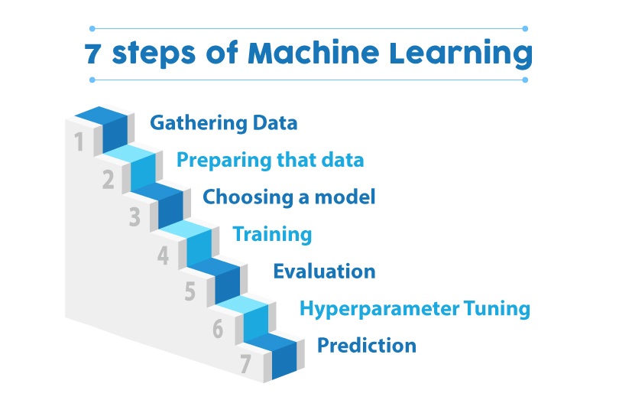
Machine Learning :
Machine learning (ML) is a type of artificial intelligence (AI) that allows software applications to become more accurate at predicting outcomes without being explicitly programmed to do so. Machine learning algorithms use historical data as input to predict new output values.

Slide 8
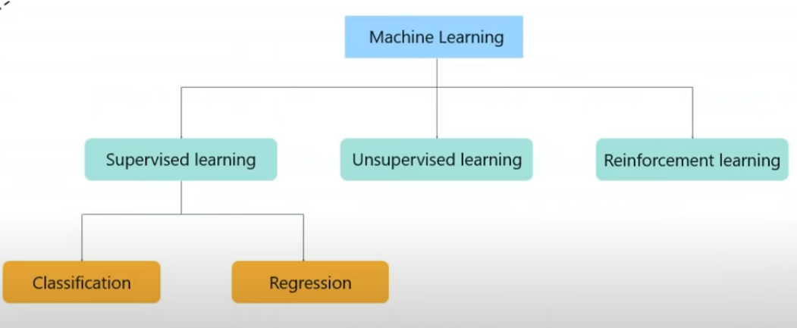
Types of Machine Learning :
Linear Regression

Slide 9
Long Short Term Memory (LSTM) Model

Slide 10
LSTM: LSTM (Long Short-Term Memory) is a type of recurrent neural network (RNN) architecture. It is designed to overcome the vanishing gradient problem in traditional RNNs, enabling better modeling of long-term dependencies in sequential data. LSTM uses a memory cell and gating mechanisms to selectively retain and update information, making it effective for tasks like natural language processing and time series prediction.

Slide 11
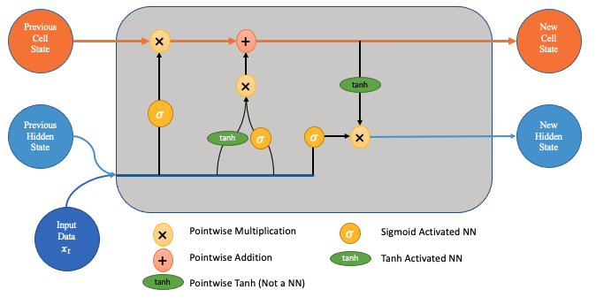
Structure of LSTM:
LSTM has a chain structure that contains four neural networks and different memory blocks called cells.

Slide 12
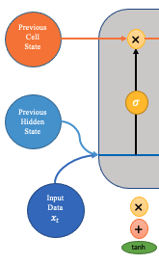
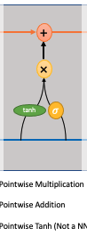
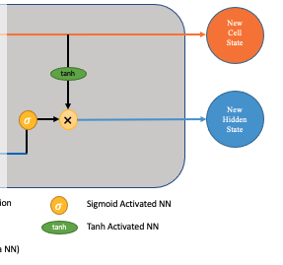
Information is retained in LSTM by the cells and the memory manipulations are done by the gates. There are three gates –
Forget Gate
.
Input gate
Output gate

Slide 13
LSTM Applications
LSTM networks find useful applications in the following areas:
Language modelling
Machine translation
Handwriting recognition
Image captioning
Image generation using attention models
Question answering

Slide 14
LSTM Implementation :
Step 1: Prepare the data by converting it into suitable input sequences.
Step 2: Split the data into training and testing sets.
Step 3: Build an LSTM model architecture, including input, LSTM layers, and output layer.
Step 4: Compile the model with appropriate loss and optimization functions.
Step 5: Train the LSTM model on the training data.
Step 6: Evaluate the model's performance on the testing data.
Step 7: Make predictions using the trained LSTM model on new data.
Step 8: Assess the accuracy of the predictions using evaluation metrics.

Slide 15
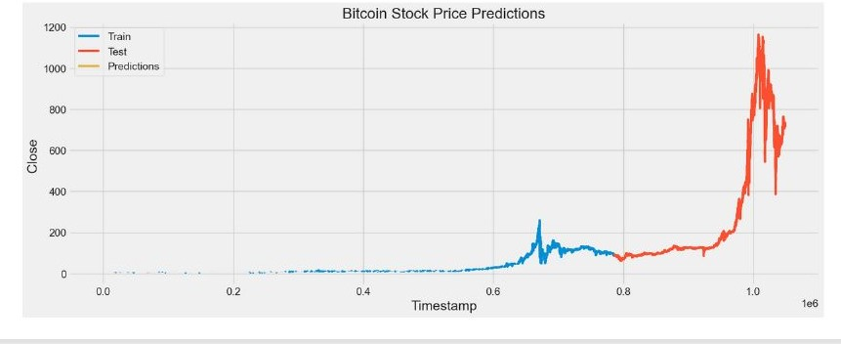
LSTM Result Obtained :

Slide 16
ARIMA (Autoregressive Integrated Moving Average) Model:

Slide 17
ARIMA MODEL:
The ARIMA (Autoregressive Integrated Moving Average) model is a popular time series forecasting technique in machine learning. It combines autoregressive (AR), moving average (MA), and differencing (I) components. ARIMA models capture temporal dependencies, trend, and seasonality in data. By analyzing past observations, it predicts future values. It is widely used in various domains, such as finance, economics, and meteorology, to make accurate predictions and support decision-making processes.

Slide 18
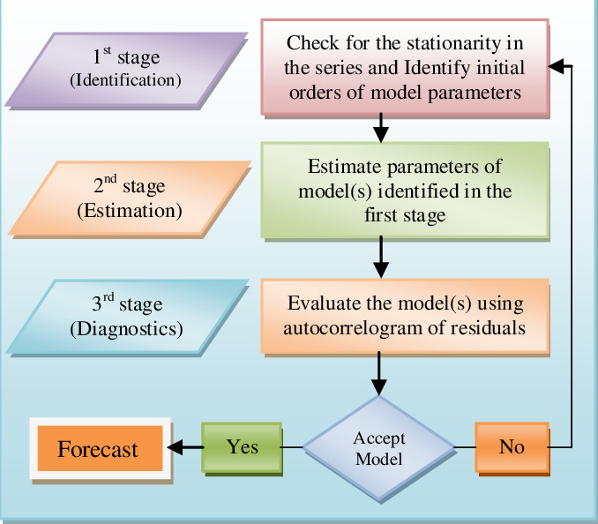
Structure of Arima Model :

Slide 19
ARIMA Applications:
ARIMA networks find useful applications in the following areas:
Finance and Economics
Demand Forecasting
Energy Sector
Sales and Marketing
Healthcare

Slide 20
ARIMA Implementation :
Step 1: Check if the data is stationary.
Step 2: If not stationary, apply differencing to make it stationary.
Step 3: Determine the order of differencing (d), autoregressive (p), and moving average (q) terms by analyzing the autocorrelation and partial autocorrelation plots.
Step 4: Fit the ARIMA model to the differenced data.
Step 5: Validate the model using statistical tests and diagnostic plots.
Step 6: Forecast future values using the trained model.
Step 7: Evaluate the model's accuracy using appropriate metrics.
Step 8 (optional): Refine the model by adjusting the order of terms or applying seasonal ARIMA if necessary.

Slide 21
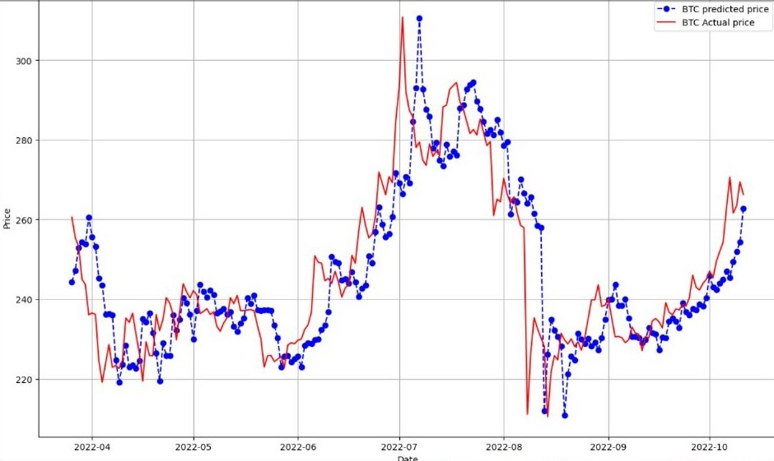
ARIMA Result Obtained :

Slide 22
THANKS!

